Slide 1
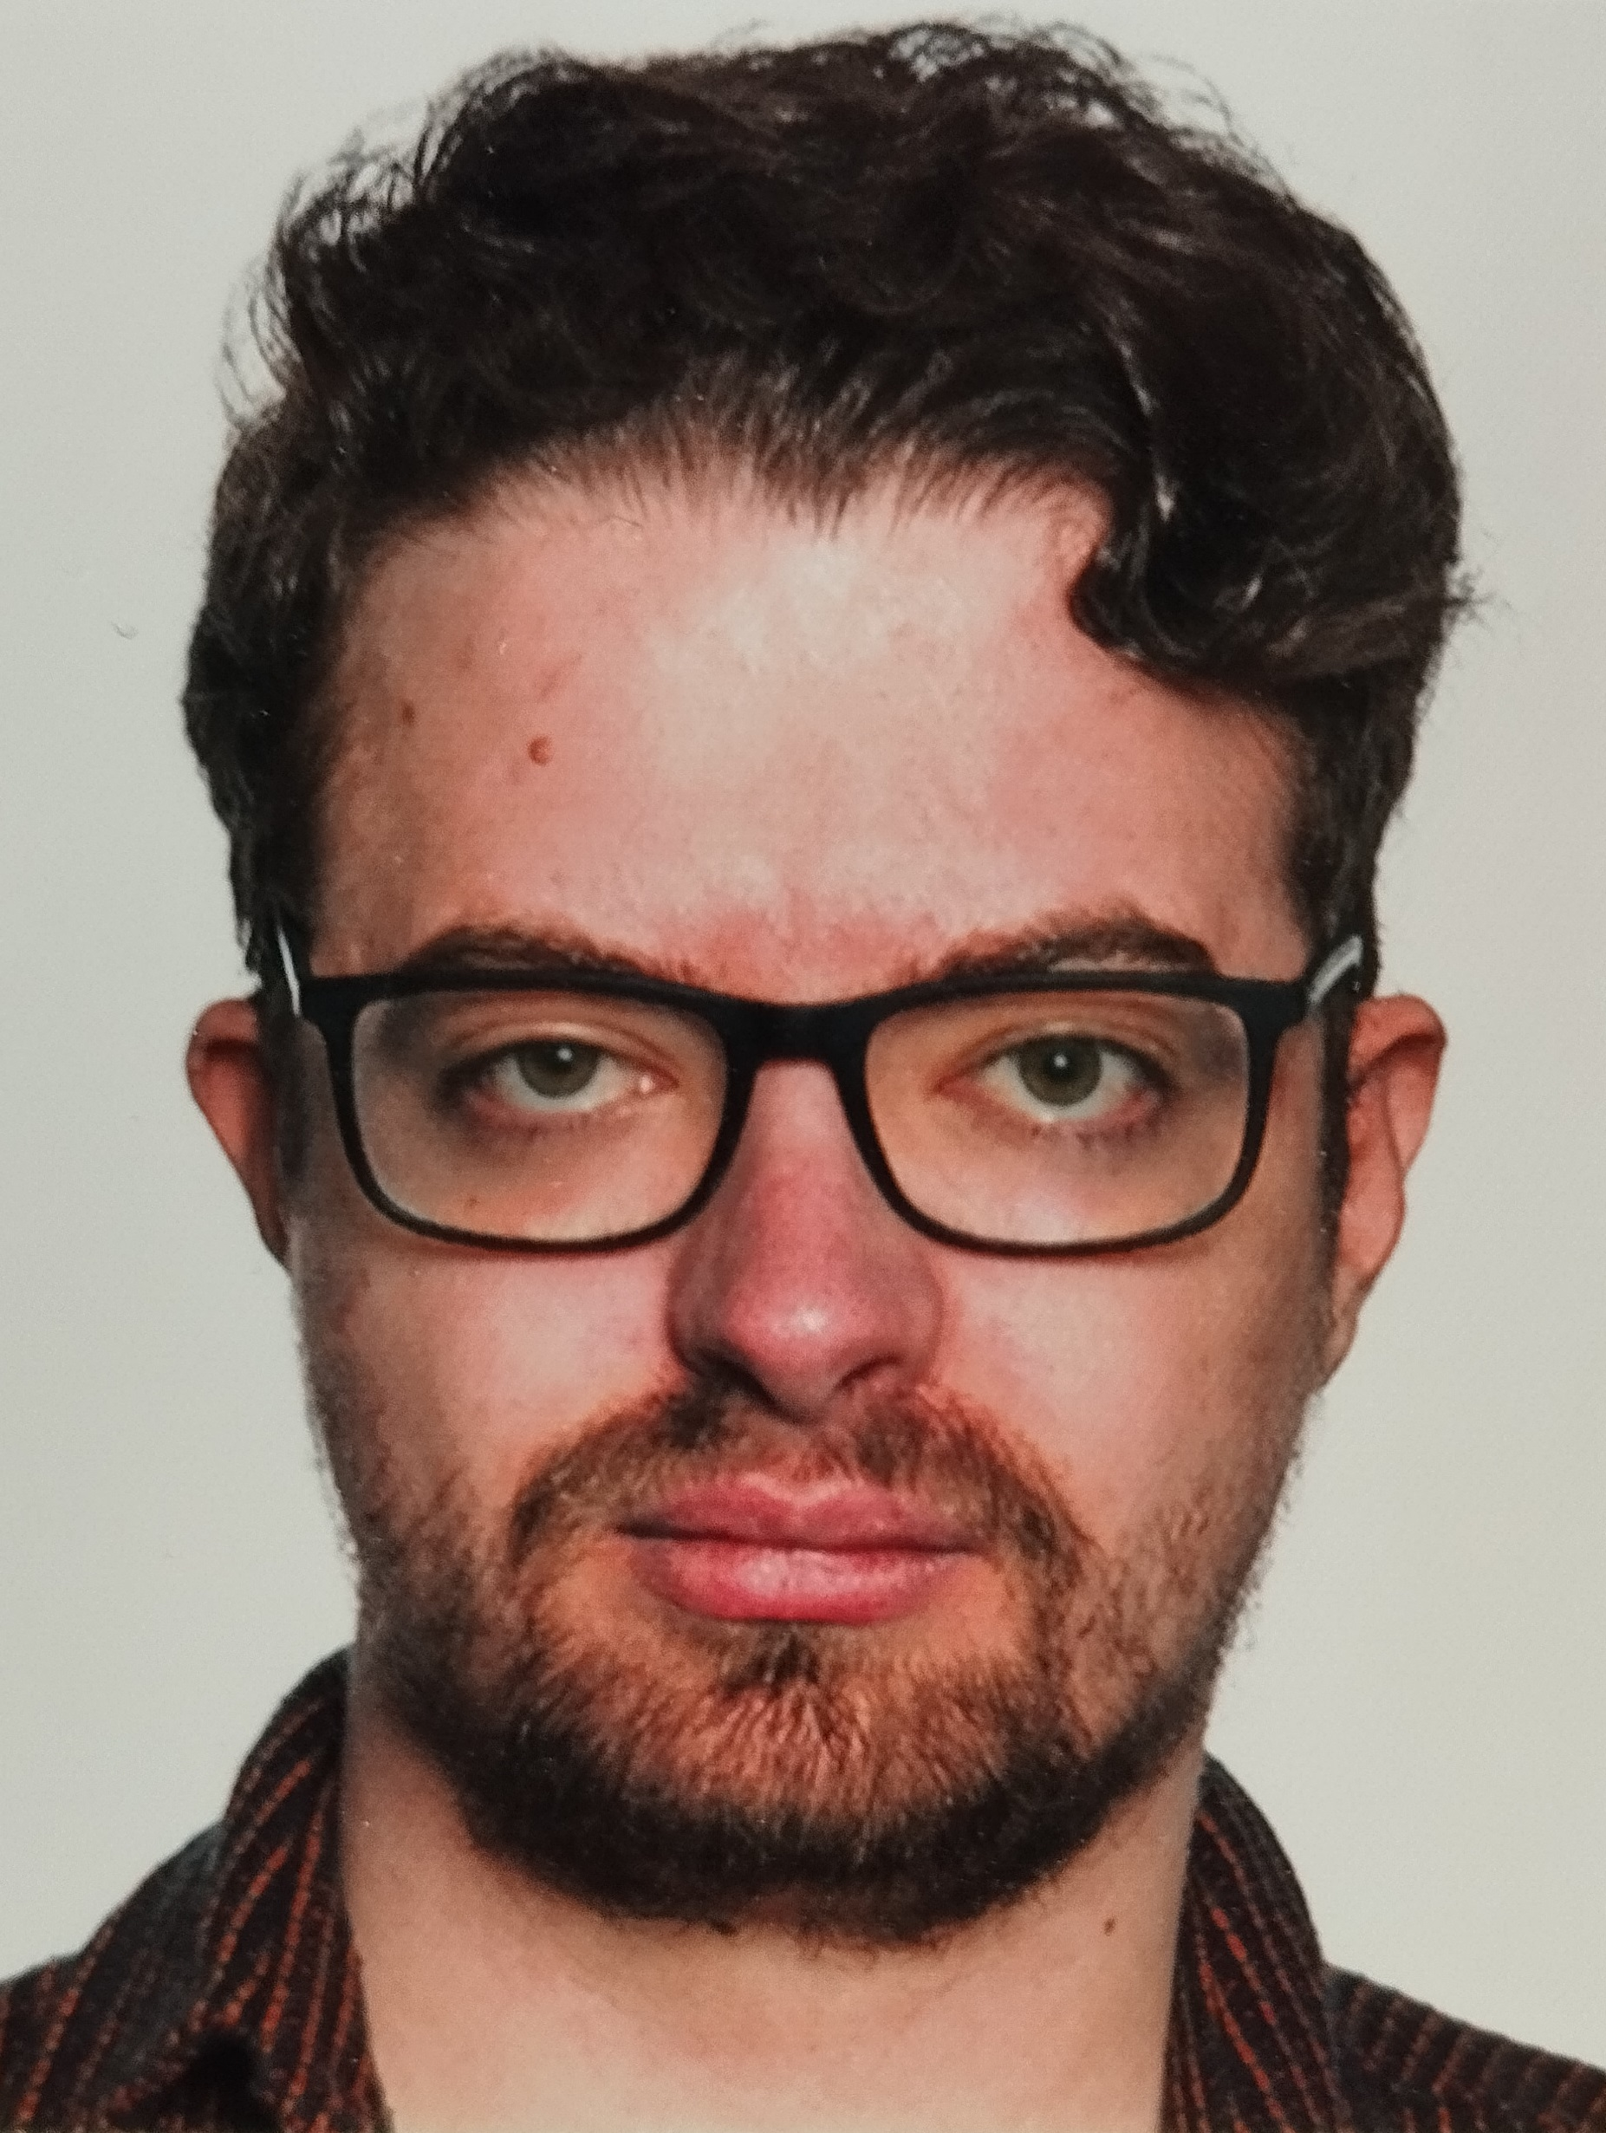
«Franz Oehler» «254125»
PROGRAMMING
CMGT Intake
2025-26

Slide 2

How To Use This Template
As an applicant at Breda University of Applied Sciences for the Creative Media and Games Technologies (CMGT) undergraduate programme you are required to provide evidence that demonstrates your current level and other factors required for pre-selection assessment and potential interview. The course is taught in English, so all submissions must be in English.
With the evidence you present here teachers should obtain a clear and comprehensive overview of your current state of progress as well as your general attitude and performance as a student and as an aspiring professional game developer.
This presentation is intended to provide you with a well-structured and organised format for doing this effectively. Please follow the directions on each slide to help ensure you supply the information required. Please do not spend time formatting the style of the presentation. Only insert extra slides where it says you can otherwise use the space, word count and font size provided. Also be sure to add your details where requested (for example on the first slide).
Make sure to read the assignment carefully (to be found in section B). Evidence needs to be provided in this presentation as well as during the interview (if applicable).

Slide 3
A
Education information
Please state your current education level
(e.g.: school/college)
School
If you are studying/have studied programming or game development at higher/college level, please state the college name, course and diploma/degree awarded
(e.g.: Breda University of Applied Science. Creative Media and Game Technologies. Bachelor's Degree)
Philipps-Universität Marburg. Data Science. No degree.
Philipps-Universität Marburg. Informatik. No degree.
(only for Dutch students. If you are uncertain the answer is no) Have you studied at a Technasium? (Yes/no)

Slide 4
B
Programming Assignment – Brief
We have created this programming assignment to assess your suitability for our educational program. This might be your first experience with programming and game development. We have created a series of tutorials to help you get started. You can find it here: https://www.3dgep.com/cpp-fast-track-1-getting-started/ We recommend that you follow this tutorial series step-by-step from start to finish. This will take some time and dedication.
Carefully read the instructions. If something is not clear, please let us know. We don’t expect you to build a commercial quality game for this assignment. Most of you are new to programming and we’ll take this into account when assessing the work. However, we do want to see that you put in effort and that you give it your best. Good luck!

Slide 5
B
Programming Assignment – Brief (continued)
Programming your own Game
Requirements:
The theme of your game should be ‘Collide’. You can interpret the theme from very literal to very abstract.
The game must be written in C++.
The game must have graphical gameplay.
You are allowed to use the template from the tutorial series (mentioned above) as a starting point for your own game.
Another highly recommended option is to use SFML which you can find here: https://www.sfml-dev.org/ SFML is well documented and comes with clear step-by-step tutorials to get you started.
The game must be your own work, but you are allowed to use external libraries. However, you are not allowed to use a game engine (like Unity or Unreal Engine)
You are allowed to use existing art assets (images, 3d models, audio, etc) or use simple shapes (lines, boxes, circles, etc). You will be assessed on the quality of your code, not the quality of the assets. Example assets: https://itch.io/game-assets
If you use existing source code, tutorials and/or art assets from others then state this clearly.
Your game should compile using Visual Studio Community (https://visualstudio.microsoft.com/vs/community) which is freely available.
Your code is well structured and commented.
You must provide a zip-file that contains the full project (including assets, source code and other dependencies) that we can build and run without installing additional software. Test your zip-file before you upload it: extract the zip-file to a new folder and check that you can successfully compile and run your game (in debug and release mode).
Include a readme.txt explaining how to play the game (including which buttons/keys to use)

Slide 6
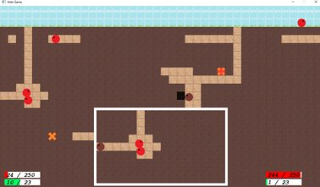
B
Programming Assignment – Brief (continued)
(‘Ants’ – An example project from a previous year)
If you have never programmed before, then along with the online tutorials we mentioned above we also recommend the book Beginning C++ Through Game Programming (4th Edition) by Michael Dawson (2006) published by Course Technology (EAN 9781305109919). Although this book does not go into graphical games, it is still highly recommended that you work through this book before you begin your study as this helps with your C++ foundation. Please sign into Microsoft Teams as soon as possible to get latest information and support.

Slide 7
B
Programming Assignment – Summary
Did you already have experience with programming? If so, did you use C++ before?
How much time did you spend on the assignment? Give a rough estimate.
What learning resources did you use?
I already had experience with programming due to studying CS related topics in university.
Due to time constraints I started properly as late as late April. It took me between 50 - 60 hours everything included.
I used the provided tutorial (3dgep) and official C++ Documentation

Slide 8
B
Programming Assignment – Game Description
The player controls a boulder crushing obstacles, accelerating and slowing down.
Crushing obstacles gives different currencies.
When coming to a halt the boulder can be upgraded.
When breaking, a new Boulder has to be purchased.

Slide 9
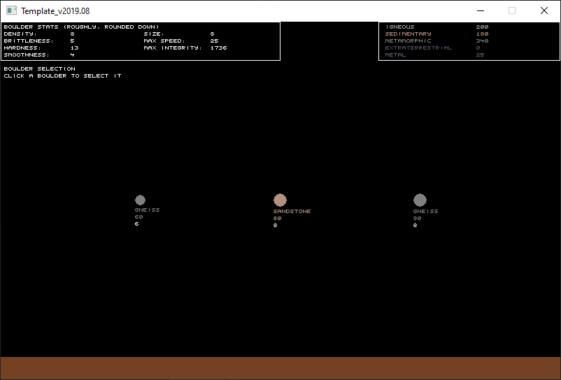
B
Programming Assignment - Media

Slide 10
B
Relevant Portfolio, Skills & Knowledge
Skills & Knowledge
Good code reading skills
Experience in a variety of programming languages
E.g. Java, Python, Ruby, a little C#, among others
Experience in working with and around code not written by me
Basic knowledge of various CS Topics (IT Security, software engineering...)
Work experience in End User Computing (Aspects of which are applicable in Game Development)

Slide 11
B
Relevant Portfolio, Skills & Knowledge
Relevant traits & history
Creative
Semi-active in Indie/Fan game development for years
Decent musician
This shows ability to commit to learn and improve a skill
Also this shows the ability to work (play) with others
Activities in the past and in preparation
Learned different Game Engines / Frameworks
Godot, Unity, RMXP
Actively looking for information on Game Development
Tinkering on projects of my own

Slide 12
B
Relevant Portfolio, Skills & Knowledge
Lack of Portfolio images:
The glaring lack of Portfolio images can be explained with the following:
Most of projects sadly did not make it into the visual stage.
Some projects are also lost to old devices etc.
In the interview, I would be able to show proof of good-ish grades in programming related modules in university.

Slide 13
End of Presentation
IMPORTANT:
Before uploading to ’My Online Application’ please rename this document using the following naming convention:
firstname_familyname_studentnumber_intake_2025-26.ppt
Thank you for participating in the intake for
CMGT Games @ Breda University of Applied Sciences

